Slide 1
SERVER –SIDE PROGRAMMING
12/22/2021
Nicole Jade Fernandez
4100E211

Slide 2
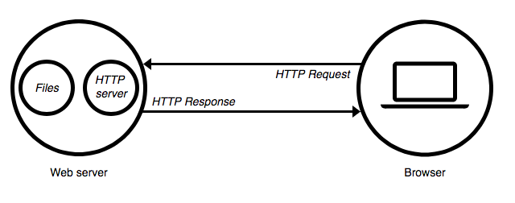
SERVER –SIDE PROGRAMMING https://medium.com/@BaaniLeen/web-development-series-intro-to-server-side-scripting-fe5626323f92
The server side programming is the name given to all types of programs which run on the web server. They process the user input, interact with the databases and control what content is served back to the client as a response to his request
Server-side processing happens when a page is first requested and when pages are posted back to the server. Examples of server-side processing are user validation, saving and retrieving data, and navigating to other pages.
It is written in a number of programming languages including PHP, NodeJS, Python, etc and has full access to the server’s OS and the programmer can chose the language he/she wants to code in.
Server-side programming is extremely useful as it helps to efficiently deliver user-customised content, and thus enhance the user experience. It can also be used to refine responses based on the user’s data (Data Analysis).

Slide 3
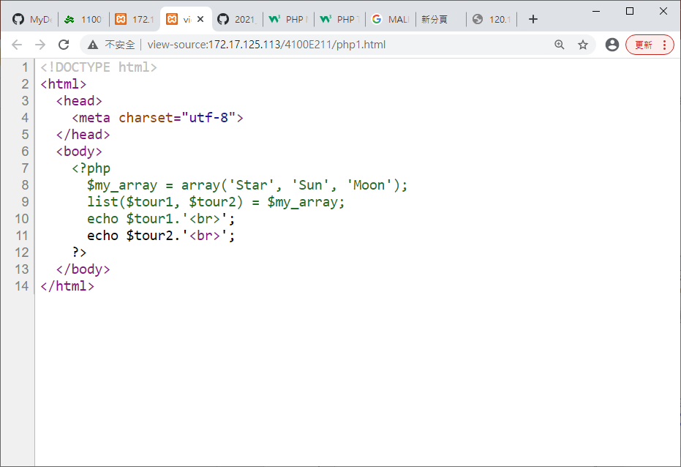
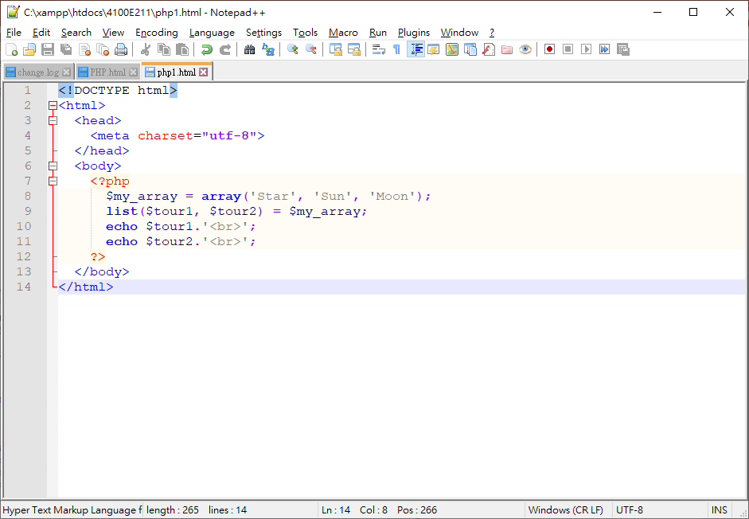
BROWSER
WHAT YOU SEE
ORIGINAL PHP PROGRAM
SERVER - SIDE PROGRAMMING

Slide 4
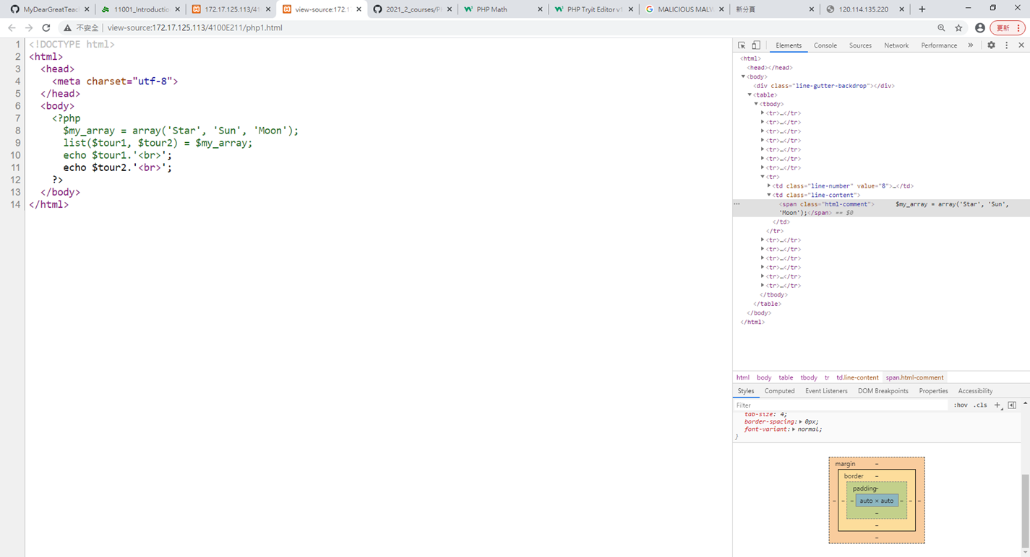
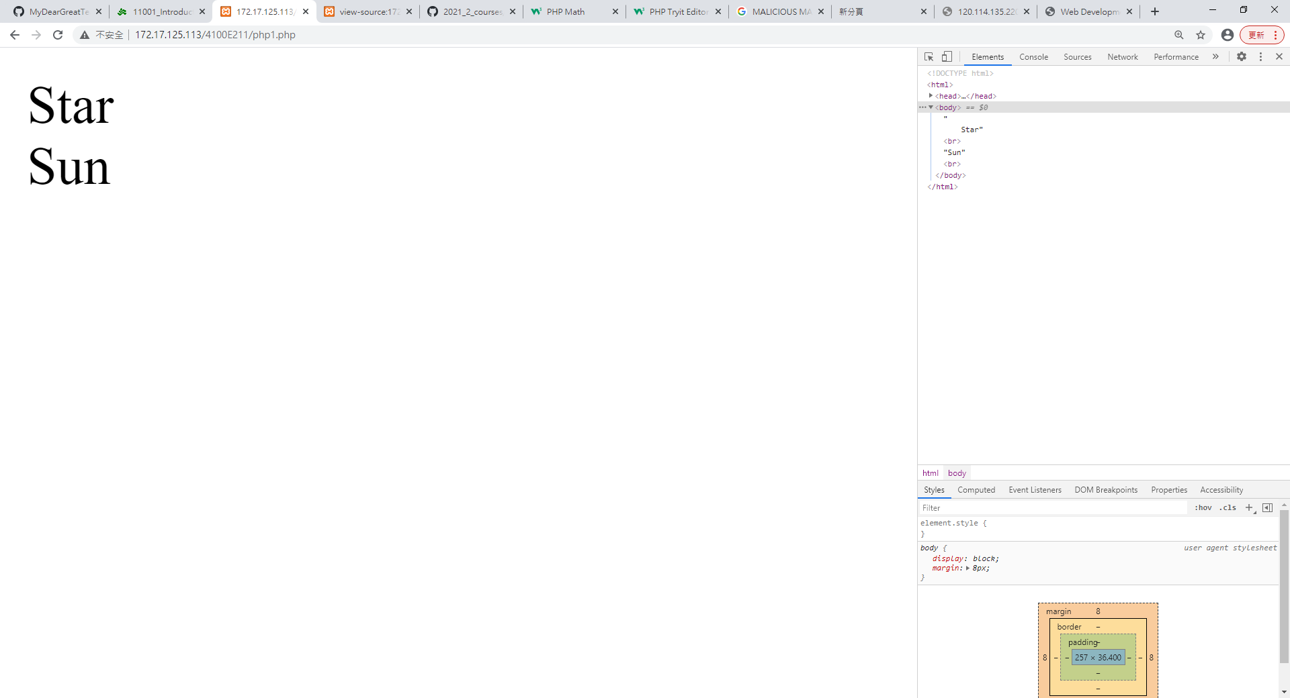
PHP1.PHP

Slide 5
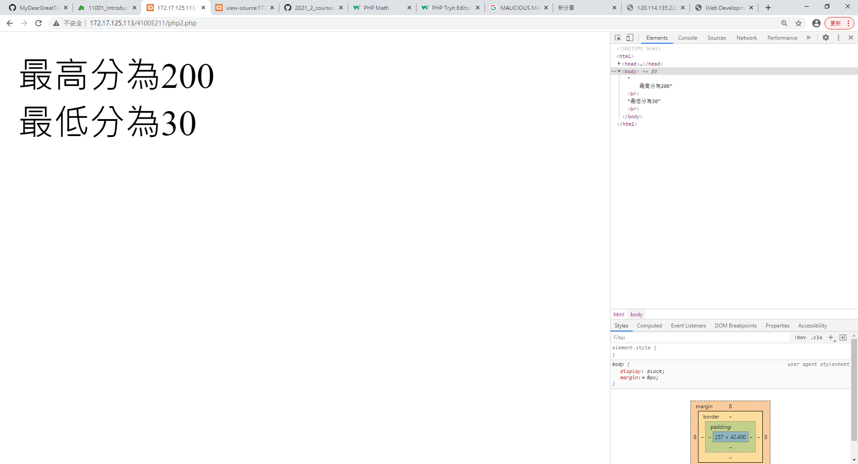
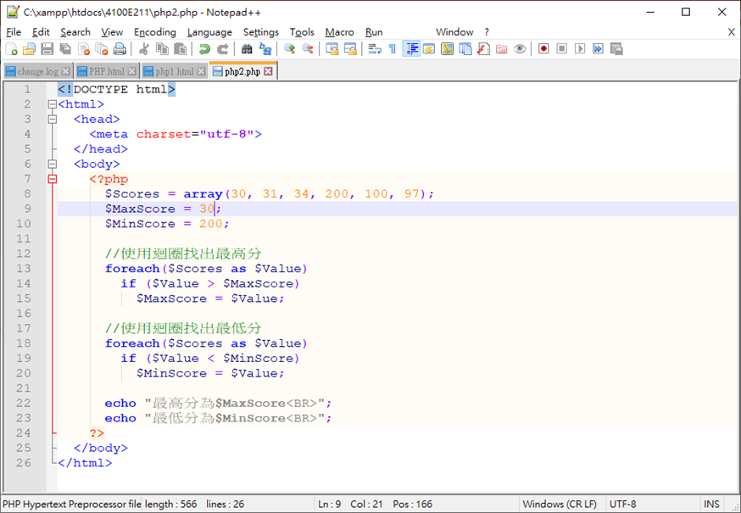
PHP2.PHP

Slide 6
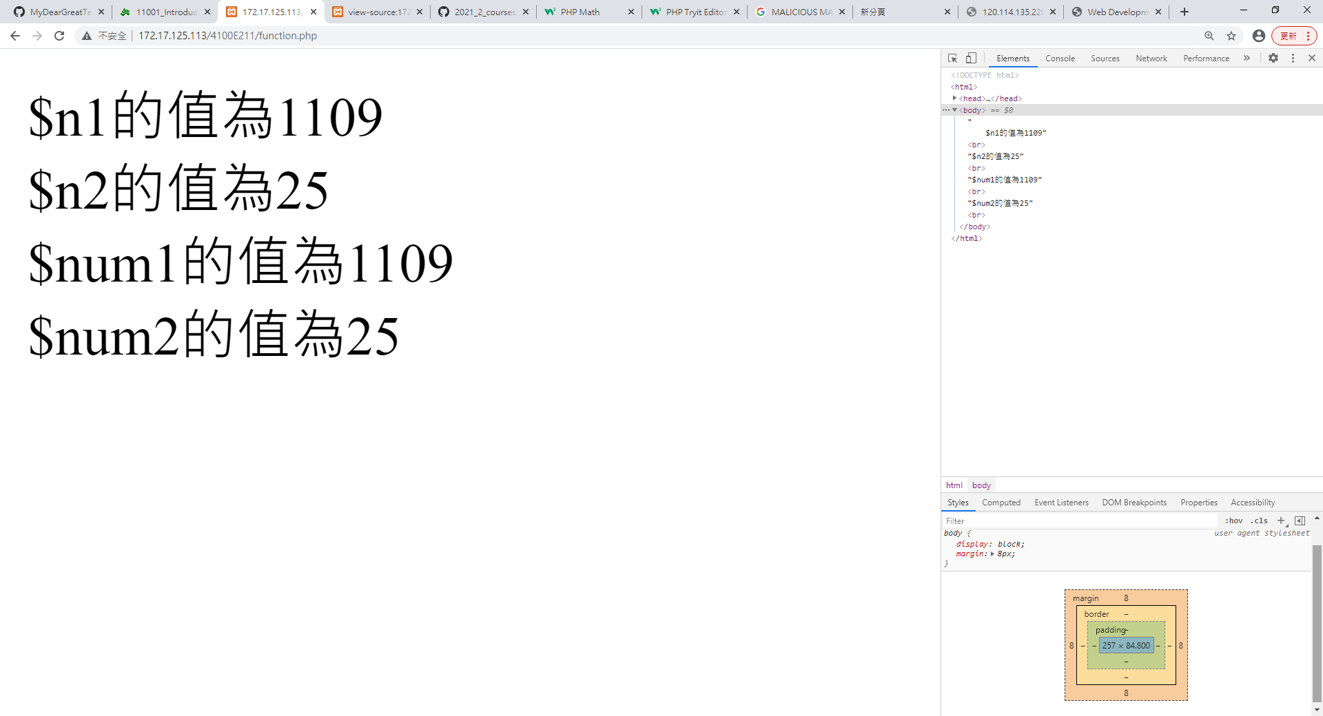
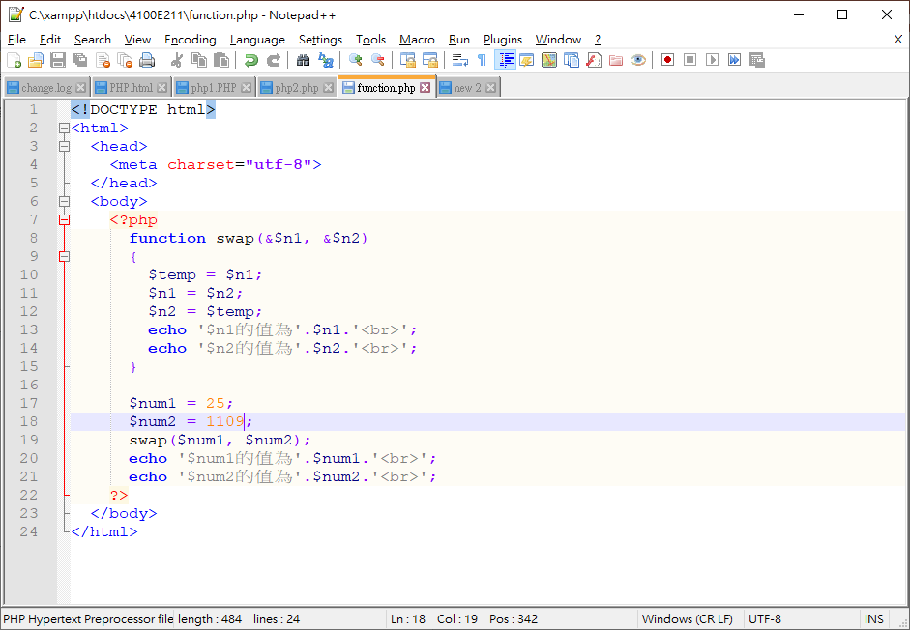
Function.php

Slide 7
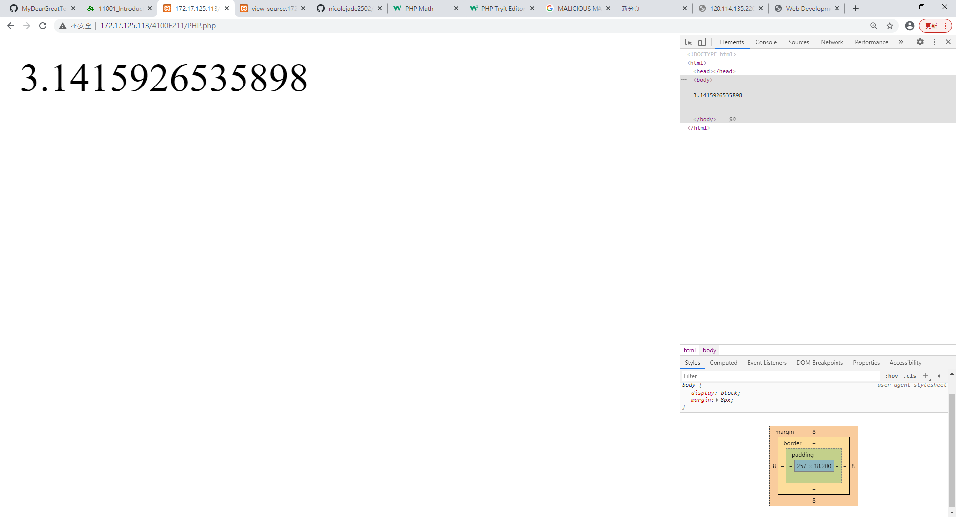
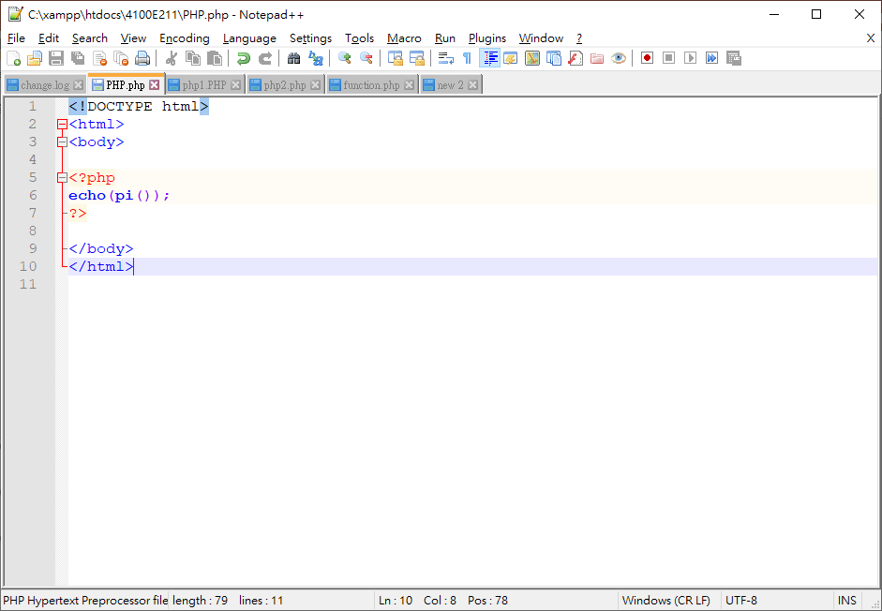
PHP.php

